Slide 1
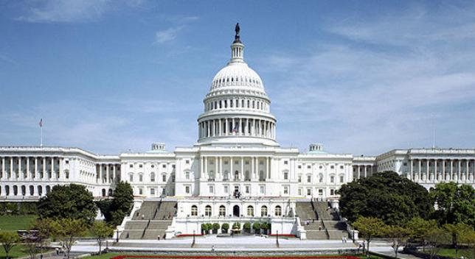
INGOA 101

Slide 2
INGOA Mission
INGOA will be the lead professional organization for the Iowa National Guard enhancing all aspects of unit readiness through legislation, professional development and lasting partnerships with our stakeholders and collaborative members.

Slide 3
WHAT WE DO FOR YOU
Bottom line up front
  Network and professional Development
Fund lobbyist to promote our agenda
  Both on a local and national level
  These are the core competencies

Slide 4
INGOA’s Core Competencies
Though INGOA has multiple committees and supports many events, there are two main missions that make us invaluable to the organization and our members.
First, is our Legislative Committee
Second, is our Professional Development efforts

Slide 5
Core Competency #1
Legislative Committee
Organization
  1VP Legislative Chair
  Air/Army Reps work service specific issues
Resolutions process
  Grassroots NGAUS Objectives on the Hill
Iowa Legislative agenda
  Bi-annual visits to Congressional Delegation
  Relationships with MLAs
  Sync with TAG and EANGI, but independent
  State Legislative Priorities

Slide 6
Core Competency #1 (cont)
Legislative Committee
Legislative achievements
  National Guard Empowerment
  Pos 9/11 GI Bill
  Overturning proposed Air National Guard cuts
  Modernizing the Army Guard
  Reemployment rights for Title 32 NG duty
  Extended TRICARE coverage for “Gray Area” retirees
  1 UTA = 1 day pay
  90 days deployed = 90 days earlier retirement pension

Slide 7
Core Competency #2
Professional Development
Professionals belong to Professional Organizations.
  Accountants-AAA, AICPA
  Lawyers- American Bar Association
  Bankers- American Bankers Association
Provides opportunity to network outside your unit.
  Get to know other peers and senior officers that can influence your future career.
Receive mentorship by senior leaders.
  Many opportunities to speak one-on-one with a senior mentor.
Broader perspective of National Guard.
  Officers often only have perspective on what influences them.

Slide 8
Association Committees
Company Grade
  Mission of the company grade rep is to bring the issues to the table that effect CPTs & LTs
  Speak on behalf of the company grade officers at the board meeting.
  NGAUS sponsorship - INGOA Sponsors 6 junior officers to attend the annual NGAUS conference.
Warrant Officer
  Mission of the Warrant Officer rep is to bring the issues to the table that effect the Warrant Corps
Membership
  Mission is to enhance, track, and report membership at state and national level. Larger membership speaks louder on the Hill, there are strength in numbers.

Slide 9
Association Committees (cont)
Corporate Membership
  Helps financially support the goals of the organization
Awards
  Recognizes members of the organization at the state and national level – always looking for more members to recognize
Alumni
  Focuses on increasing retiree involvement and coordinating retiree activities
Time and Place
  Determines the dates and locations of future conferences
Nominations
  Focused recruiting people to fill elected officer positions within the Board of Directors

Slide 10
Structure of Membership
Organization –
  Elected as the Area President by their respective areas:
  Area 1 (Air Guard HQ & 132nd FW) Area 2 (2nd BCT)
  Area 3 (734th RSG) Area 4 (JFHQ and 671st TC)
  Area 5 (185th ARW & 133rd TS) Area 6 (67th TC)
  Area 7 (Separate Units)
Area President Roles-
  Attends INGOA meetings and updates the INGOA Pres on their respective areas (ex. Fees, awards, etc…)
  Communicates activity back to the areas they represent – to include: events, NGUAS updates, INGOA updates, annual conference etc…
  Is a voting member at INGOA meetings – and shall conduct business as appropriate

Slide 11
SSLI and the Foundation
The INGOA has an Insurance program. State sponsored Life Insurance (SSLI) which is made available to active, drilling or separated members and dependents. It is very, very competitive.
INGOA Foundation: A non-profit organization that works closely with the Association to foster the personal and professional development of our junior officers.

Slide 12
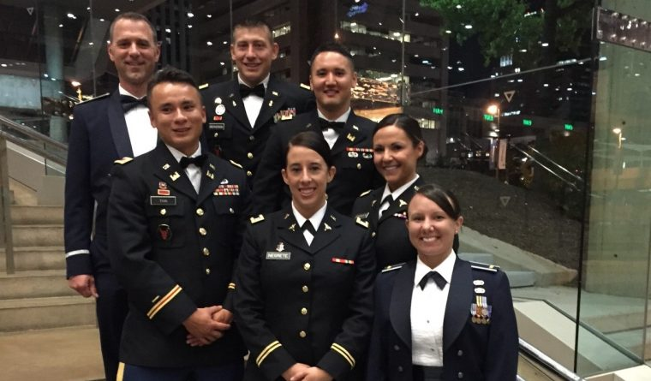
2016 OPD Grant Recipients
NGAUS Conference Baltimore, Maryland 2016
Sponsored by the INGOA Foundation

Slide 13
Myth Buster
Myth: “I would like to be involved, but I don’t have a lot of extra time!”
Fact: There are many ways to get involved with various time commitment levels.
Myth: “There’s enough people already involved.”
Fact: Strength comes in numbers. There are many committees with only one committee chair that could use additional assistance.
Myth: “I am interested in attending the monthly meetings, but I don’t live in the Des Moines area.”
Fact: We have many members that call in to the meeting and that contribute from outside the DSM area.

Slide 14
Letter from MG (Ret) Greg Schwab

