Slide 1
Membership
National Guard Association of the United States
Michele Mahoney

Slide 2
Agenda
Membership 101
Benefits
Getting Involved

Slide 3
Membership 101

Slide 4
Membership Eligibility
NGAUS Membership is offered to:
All currently serving, separated and retired commissioned and warrant officers of the National Guard
Complimentary Membership
Active Annual
Active Life
Separated/Retired Life
Enlisted personnel, families and supporters of the National Guard
Non-voting membership
Associate Annual
Associate Life
Notes:
Newly commissioned, warrant officers and those newly assessed to the NG are eligible to receive a Complimentary membership for a period of one full year and any portion of the year in which they are appointed.

Slide 5
Membership Dues
Company Grade | O1, O2, O3, WO1, CW2, CW3 | $40.00
Field Grade | O4, O5, O6, CW4, CW5 | $80.00
Flag Officer | O7, O8, O9, O10 | $130.00
Active Life Membership | $1,000
Active Annual Membership: Dues are collected based on pay grade
Active Life Membership: Paid once or in installments for a lifetime membership
$250 every 6 months for two years
$100 every month for ten months
Notes:
Annual membership counts for the full year, Jan-Dec. These dues are based on pay grade. Active life memberships can be paid once in full, $250 ever 6 months or $100 for 10 months. If someone is an Active Life Member, they stay an Active Life Member even after retirement or separation. This means the member counts toward their state’s percentage for the rest of their life.

Slide 6
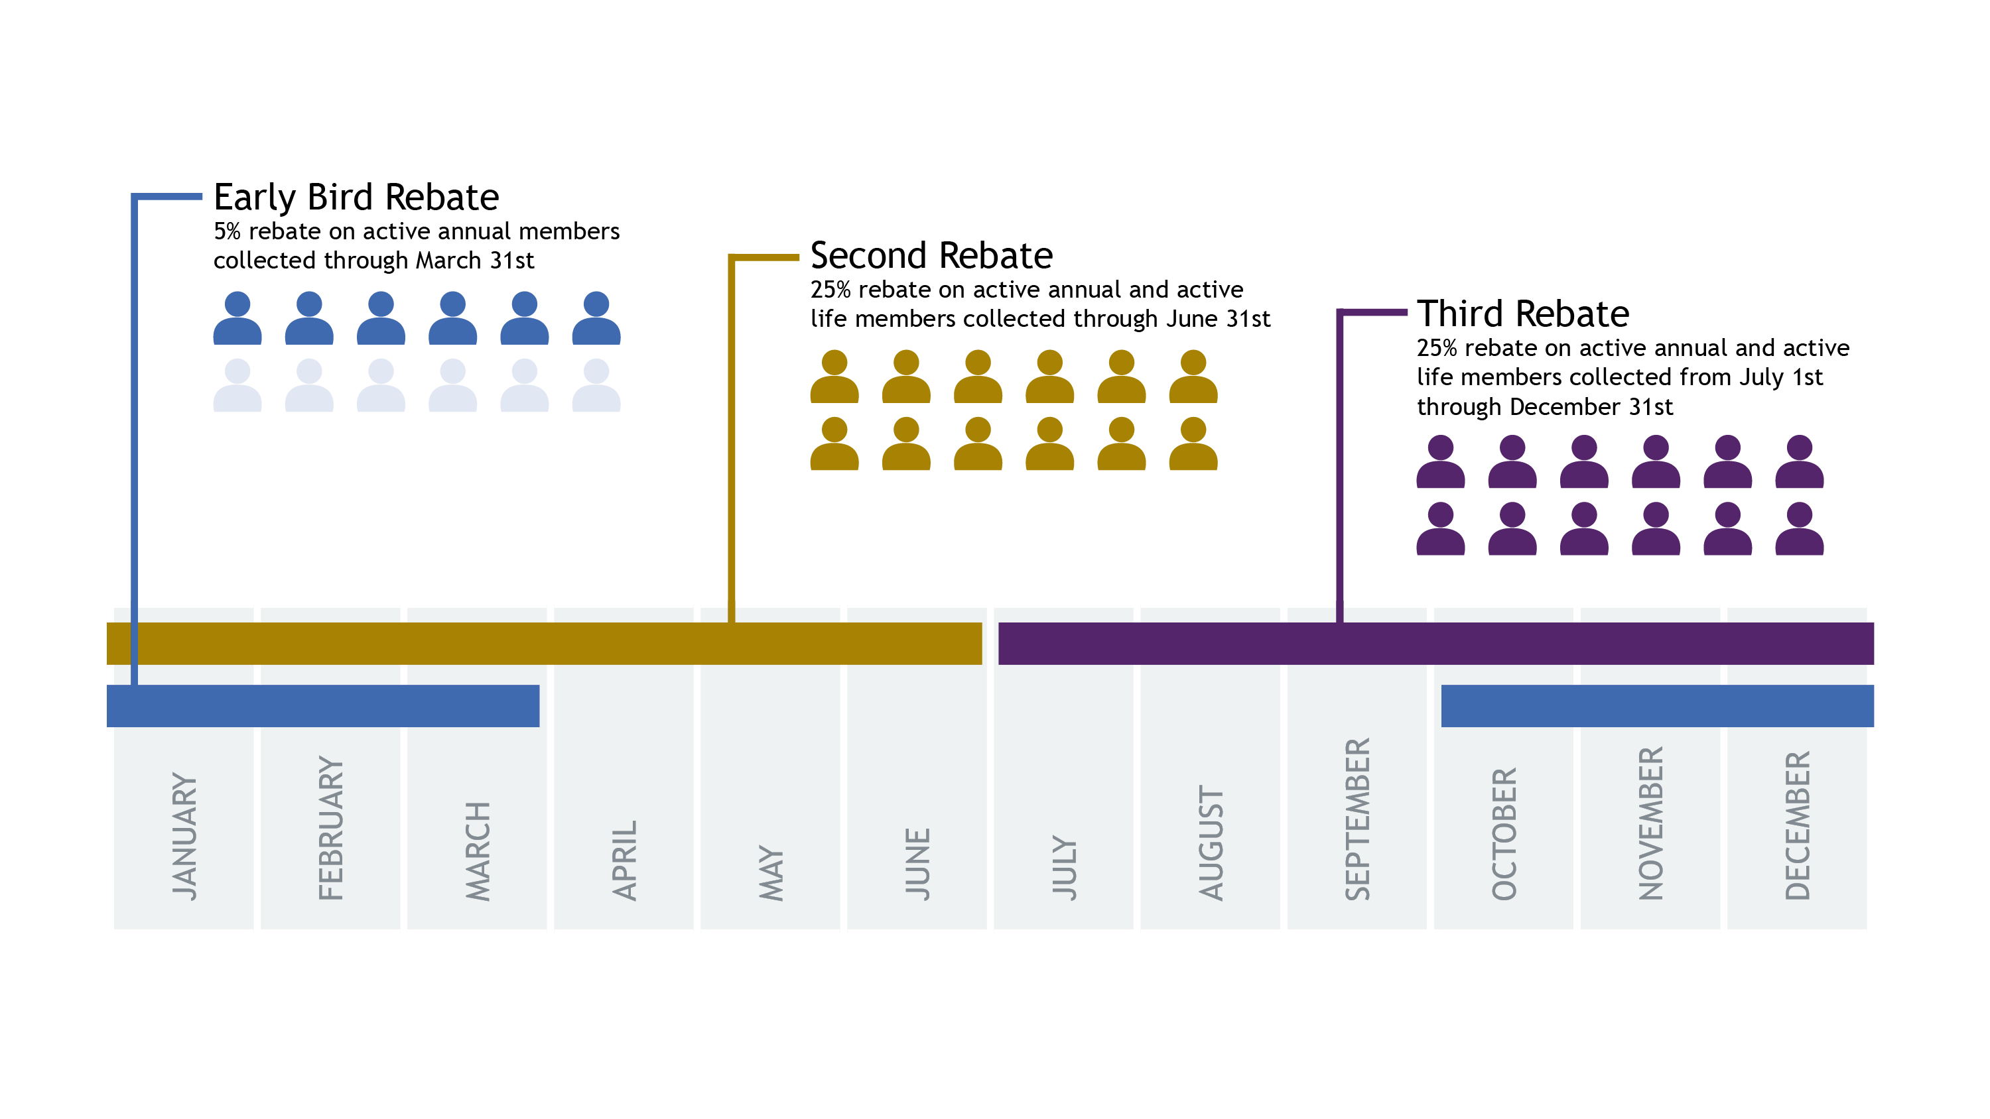
Rebates and Performance Incentives
Notes:
Membership Performance Incentive (formerly 25% Rebate)
Any state at or above 50% membership will be eligible for a 25% rebate on all Active Annual and Active Life dues collected, input into the NGAUS database and post-marked to NGAUS by June 30th
Any state below 50% that increases its membership percentage by at least 1% will be eligible for a 25% rebate on all Active Annual and Active Life dues collected, input into the NGAUS database and post-marked to NGAUS by June 30th
States below 50% that do not improve their membership year over year will not be eligible for the 25% rebate.
*All states, regardless of their membership percentage will receive 25% rebate on all NGAUS Active Life memberships sold.

Slide 7
Membership Benefits

Slide 8
Benefits
Scholarships
Educational Events
Professional Development Opportunities
Publications
Insurance Supplements

Slide 9
Scholarships
AFBA/NGAUS Active Life Member Scholarship
Award two $5,000 scholarships to a NGAUS Active Life Member or their dependent
Grantham University Scholarship
Two $14,200 scholarships, one for an active Guardsman and NGAUS member and Guardsman ranked 0-5 and below. The second for a spouse of an active member
National Guard Educational Foundation Scholarships
The Van Hipp Heroes Scholarship Fund
Leonardo DRS Guardian Scholarship Fund
Notes:
- The NGAUS AFBA Active Life Member Scholarship awards two $5,000 scholarships every July to Active Life members of NGAUS or dependents of Active Life members seeking an undergraduate, graduate or post-graduate degrees. Applicant must be full-time students. The application period runs from March 1 through May 31 and will be available at www.ngaus.org
- NGAUS and Grantham University award two full tuition graduate scholarships annually. One scholarship is for an active NGAUS member and current Guardsman who is a commissioned or warrant officer ranked 0-5 and below. The second scholarship is for a spouse of an active member. Each scholarship is valued up to $14,200, and covers tuition costs, required textbooks, software and fees. Scholarship value depends on degree selected and credits transferred.

Slide 10
Educational Events
143rd General Conference and Exhibition
September 9-12, 2021
Join us in Charlotte to hear from national defense leaders and conduct important association business..
24th Annual Industry Day
December 2021
NGAUS invites industry leaders to come to the association’s headquarters. Learn how to work with the Guard and gain insight into Guard priorities.
Notes:
From thrilling adventures to moving artistic performances, family play dates and magnetic nightlife, Charlotte holds something for everyone. As we gather to conduct association business and make decisions on the efforts of NGAUS for FY23, we get the opportunity to learn from senior leaders and connect with old friends. Join us in Charlotte for the 143rd General Conference & Exhibition.
Industry Day is a networking event aimed at connecting defense industry representatives with leaders of the Army and Air National Guard. Attended by over 230 people ranging from representatives of some the nation’s leading defense organizations to the owners of emerging small businesses with the intention of building a stronger bond between Guard leaders and industry. The primary goal of the event is to provide attendees with requirements and strategic planning of the National Guard.

Slide 11
Educational Events
Capitol Summit
Three events per year
NGAUS currently offers Army and Air National Guard company-grade officers from each state and territory to the nation’s capital for a close look at how the government works and the role NGAUS plays in the legislative process.
Legislative Workshop
An annual professional development event to educate Guardsmen, Congressional Action Contact Officers (CACOs), and National Guard State Association POCs on National Guard issues in Congress and the Department of Defense.
Notes:
The fly-ins to Washington, D.C., is one of three officer professional-development programs NGAUS currently offers Army and Air National Guard company-grade officers. The program brings Guardsmen from each state and territory to the nation’s capital for a close look at how the government works and the role NGAUS plays in the legislative process. Interested officers should contact their state or territory association executive director or president.
The NGAUS Legislative Workshop is an annual professional development event to educate Guardsmen, Congressional Action Contact Officers (CACOs), and National Guard State Association POCs on National Guard issues in Congress and the Department of Defense. Attendees hear from Members of Congress, senior Guard leaders, and Congressional staffers on National Guard issues in Washington, D.C., and how best to inform key stakeholders of the Guard’s most pressing requirements.

Slide 12
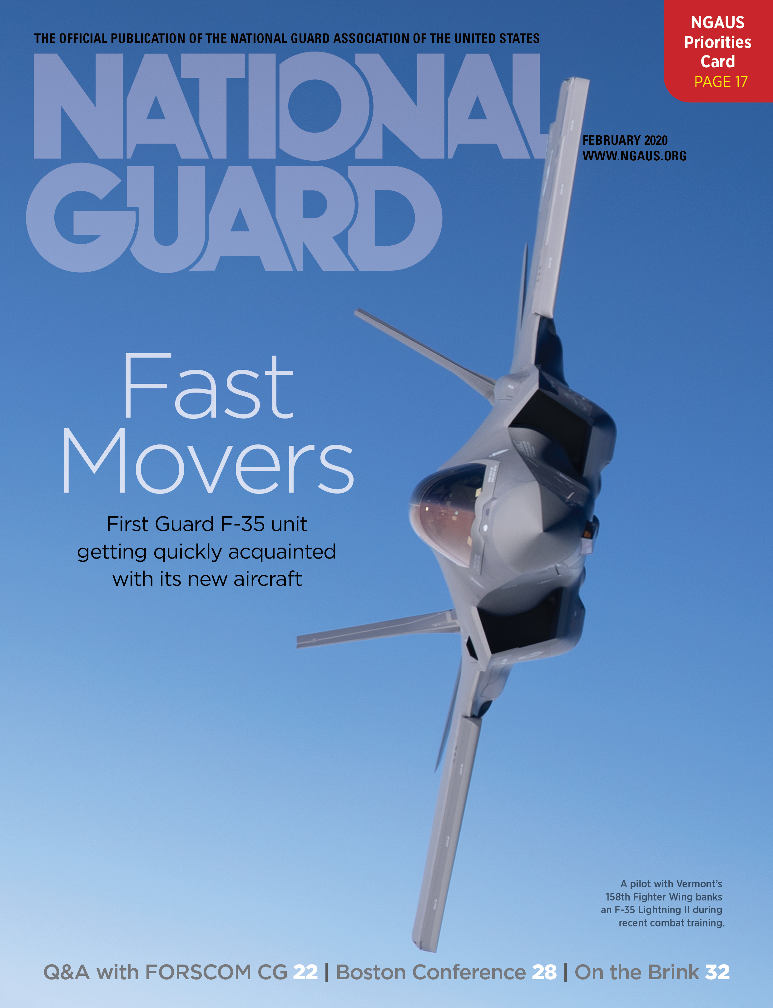
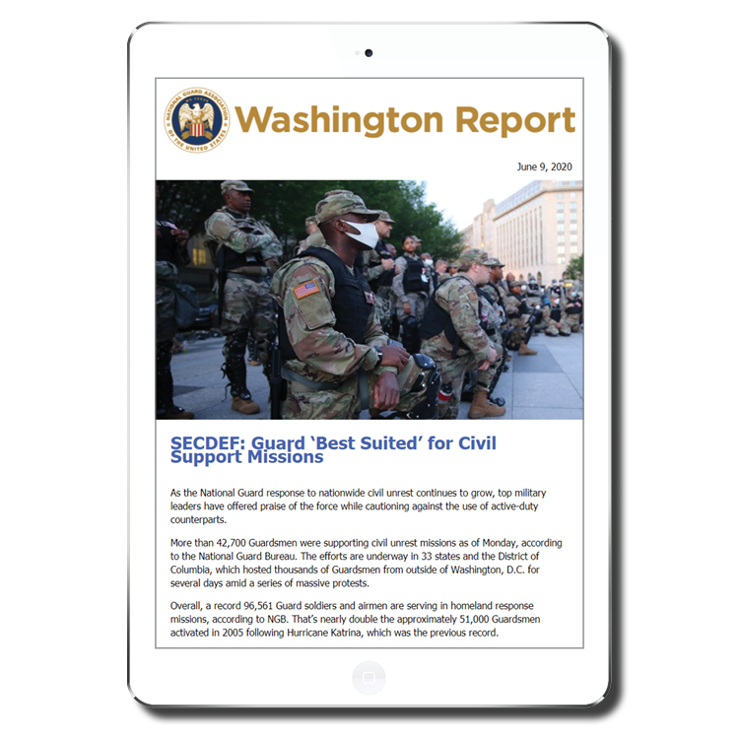
Publications
NATIONAL GUARD Magazine
Focuses on insight and analysis
Interviews with key leaders
Washington Report
Weekly e-newsletter with news from Washington affecting the Guard
NGAUS on the Hill
Monthly update on how the NGAUS Legislative team is working for you on the Hill
Legislative Analysis
Reviews provisions in defense and veterans legislation to determine impacts on National Guard servicemembers, funding, programs, and issues.
Notes:
We highly encourage members to provide us with a civilian email address to ensure they receive the Washington Report a weekly e-newsletter that provides the latest developments on NGAUS legislative efforts.

Slide 13
Social Media
@NGAUS.hq
@NGAUS1878
@NGAUS1878
@NGAUS1878
@NGAUS1878
@NGAUS1878
Notes:
Instagram, Twitter, Facebook, You Tube, Linked In, Flicker

Slide 14
Insurance Supplements
Accidental Death and Dismemberment (AD&D) Insurance
NGAUS members have an accidental death and dismemberment benefit at no extra cost.
Technicians Insurance
Available at an affordable rate to National Guard technicians under the age of 65.
Preferred Vision Care Plan
At the low cost of $15 per year, NGAUS members, Guard retirees, Guard employees and their household are eligible for the Preferred Vision Care (PVC) plan.
Term Life Insurance
NGAUS member/spouse under 65 can apply.

Slide 15
Getting Involved

Slide 16
Time to Serve
Serve on a committee at the state or national level
Serve on the Board of Directors at the state or national level
Serve on a task force at the state or national level
Start a committee your state does not currently have
Create a community through social media
Notes:
We rely on or members to volunteer and help with association business in any way they can. Here are a few ways to begin getting involved.

Slide 17
Make a Difference
Write to Congress
NGAUS provides a tool to write directly to your representative about issues | www.ngaus.org/legislation/write-congress
Begin learning about issues that have been taken to representatives at the state and national levels
Work with your state association to develop resolutions
Create a white paper or use a NGAUS white paper and begin making connections with representatives

Slide 18
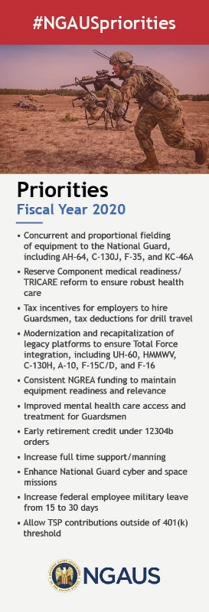
Learn and Teach
Attend the officer professional development at the NGAUS General Conference & Exhibition
Develop and expand membership at your state association
Recognize a fellow Guardsman for a NGAUS Award
Inform other Guardsmen about what NGAUS and National Guard State Associations do for them
NGAUS provides membership informational tools to help with educating others

Slide 19
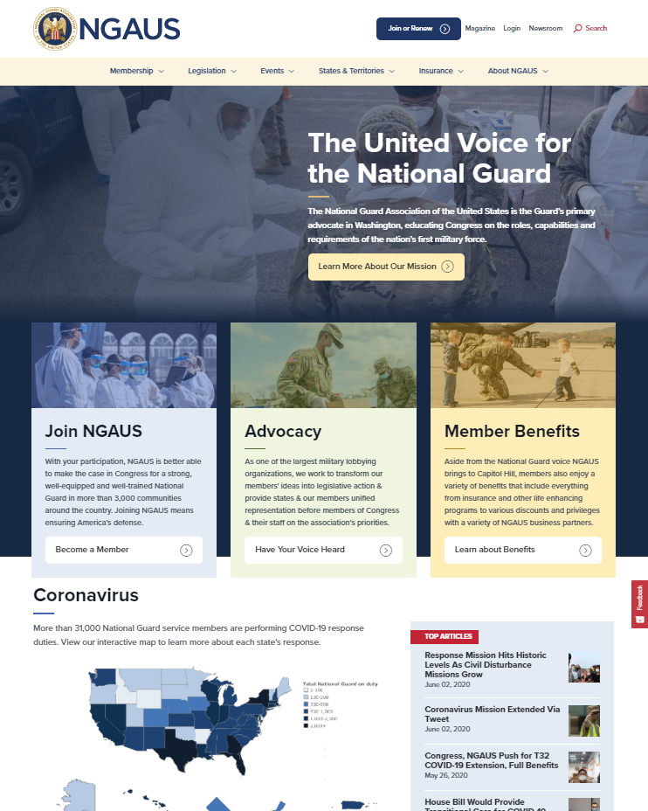
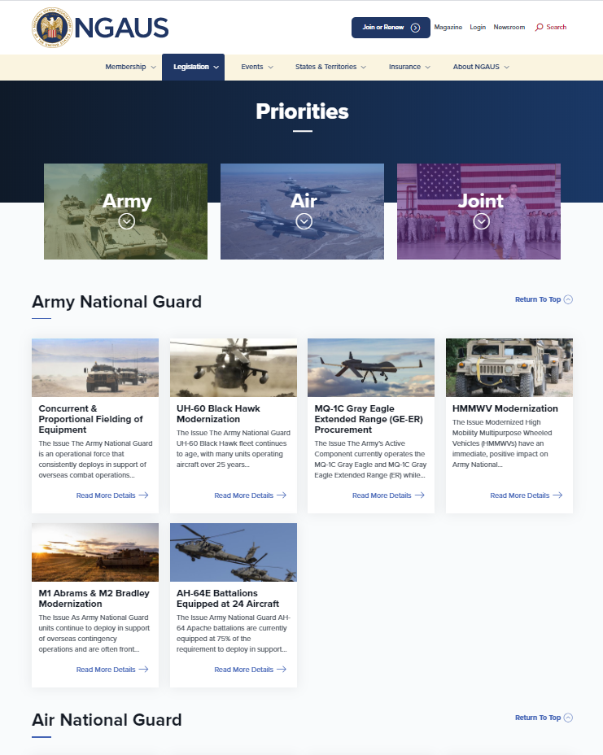
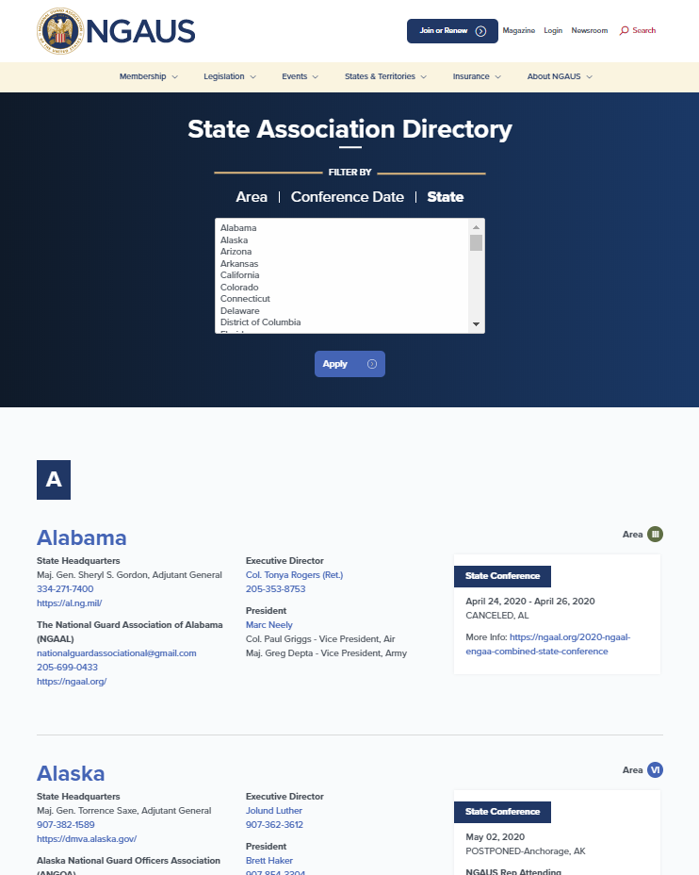
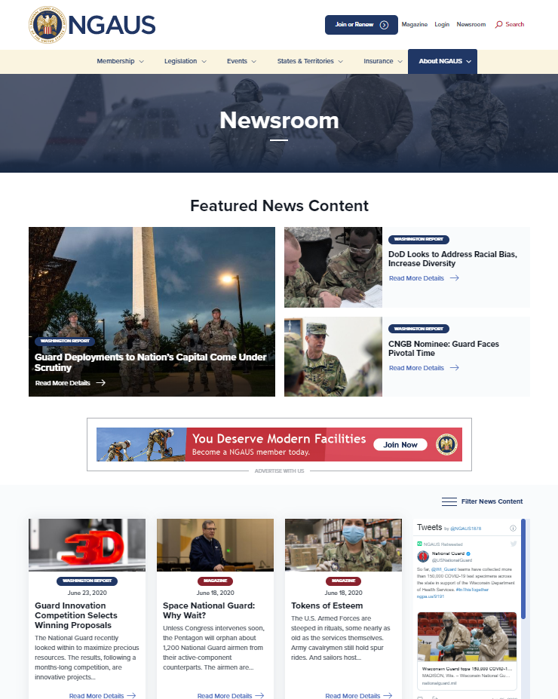
Learn and Teach
The NGAUS (www.ngaus.org) website is your tool to learn about the issues NGAUS is taking to the Hill and what is happening within the Guard all over the 54

Slide 20
Questions?

Slide 21
Top FY20 NGAUS Priorities
Army National Guard
Concurrent & Proportional Fielding of Equipment
UH-60 Black Hawk Modernization, Recapitalization
HMMWV Modernization
AH-64 Battalions Equipped at 24 Aircraft
Air National Guard
Concurrent & Proportional Fielding of Equipment
Concurrent Fielding of F-35, KC-46 Aircraft
C-130H Modernization, C-130J Recapitalization
A-10, F-15C/D, F-16 Modernization
Joint-Personnel
Reserve Component Medical Readiness/ TRICARE reform
Improved Mental Health Care Access & Treatment for Guardsmen
Early Retirement Credit under 12304b Orders
Consistent NGREA Funding
Increase Full Time Support/Manning
Tax Incentives for Employers to Hire Guardsmen, Tax Deductions for Drill Travel
Enhance Guard Cyber & Space Missions
Increase Annual Federal Employee Military Leave from 15 to 30 Days
Allow TSP Contributions Outside 401(k) Threshold

Slide 22
Notable FY19 Accomplishments
$421.0 million for the ARNG and $421.0 million for the ANG in NGREA funding
New UH-60 Black Hawk M-Model helicopters designated to ARNG
Continued funding for HMMWV ambulance procurement and ARNG HMMWV modernization
6 AH-64 Apache Block IIIB new-build helicopters designated to ARNG
8 C-130J aircraft for ANG and increased C-130H modernization funding
Increased funding for A-10 Thunderbolt modernization
Funding for F-15C Eagle Active Warning and Survivability Systems (EPAWSS) and ALQ-128 Electronic Warfare Warning Sets (EWWS)
Authorization for the secretaries of the Army and Air Force to adjust effective dates of promotion of Guard officers who experience delays in federal recognition of their promotion
Under 12304b orders, high deployment allowance accrual for all Reserve Component servicemembers and non-reduction in pay protections for Reserve Component servicemembers who are also federal employees in their civilian capacity
Increased funding for ARNG Cyber Protection Teams and cyber scholarships
Increased funding for ARNG and ANG mental health pilot programs

